Slide 1
Radiant Technologies, Inc.
Ferroelectric Test & Technology
Joe T. Evans, Jr.
August 22, 2016

Slide 2
Radiant Technologies
Focus on non-linear electromechanical materials technology. The company
  Designs and manufactures test instruments and their operating procedures
  Fabricates thin ferroelectric film devices
  Integrates the two disciplines to create unique functions.

Slide 3
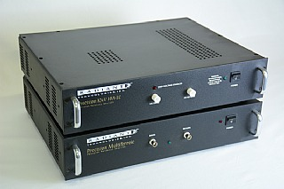
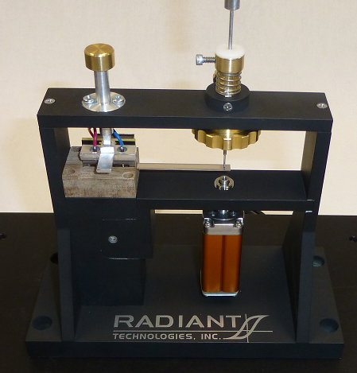
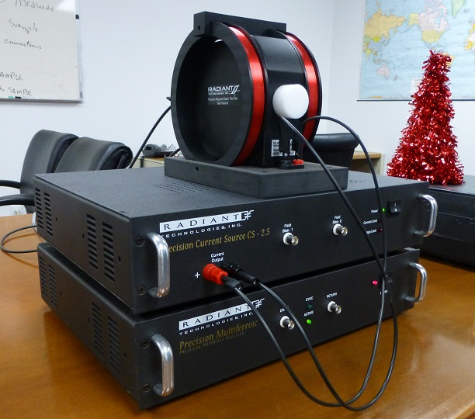
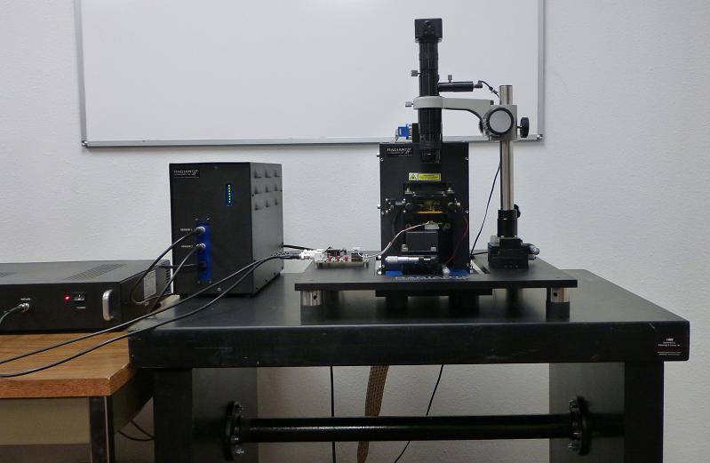
Test Instruments
Radiant pioneered ferroelectric test with the development of the first commercial test system in 1989 and now makes a variety of testers and fixtures.

Slide 4
Test Instrument vs Integrated Ferroelectrics
What follows is a series of measurements demonstrating the properties of Radiant’s thin PZT capacitors measured with Radiant test equipment.

Slide 5
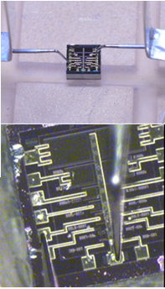
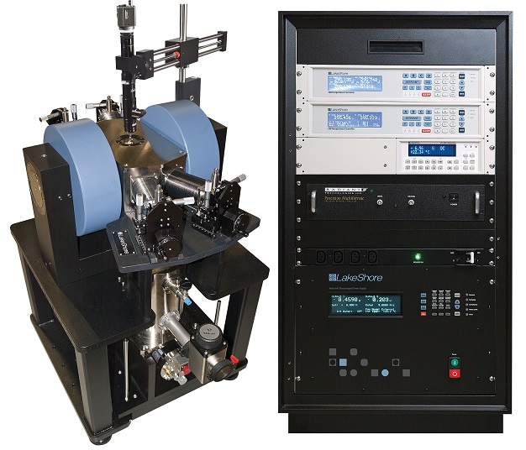
IC Scale Cryogenic Testing
Lakeshore CRM-EM-HF

Slide 6
IC Scale Cryogenic Testing
0.25μm-thick PZT from 10 K to 310 K

Slide 7
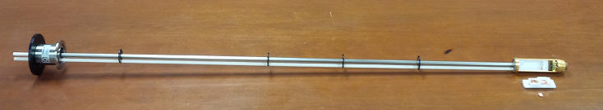
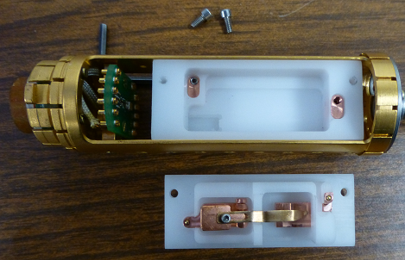
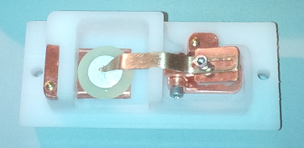
Quantum Design PPMS P450
The QD Model P450 Multifunction Probe can test disc-shaped bulk capacitors at high voltage down to 2.4 K.
B

Slide 8
Bulk Capacitors vs Temperature
Many surprises await at lower temperatures.
The sample to the right is a commercial piezoelectric PZT from CTS Wireless in Albuquerque measured in a PPMS that indicates a normal hysteresis loop at room temperature but unexpectedly has no remanent polarization at 100 K.

Slide 9
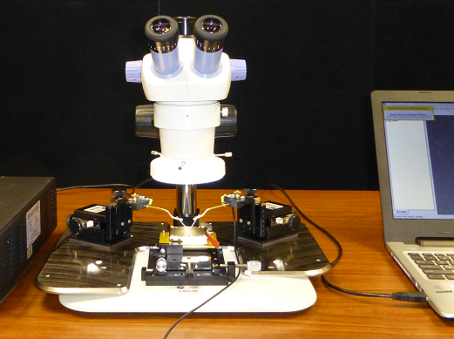
Leakage vs CV vs Remanent Polarization
Decomposing the hysteresis loop on a probe station.

Slide 10
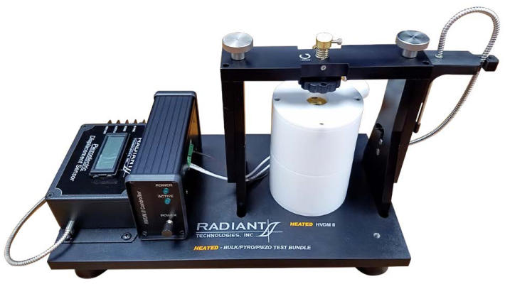
High Voltage Polarization & Piezeoelectric Loops
Bulk Capacitor displacement at high voltage and elevated temperature.

Slide 11
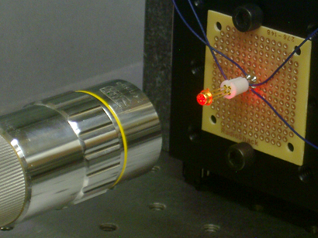
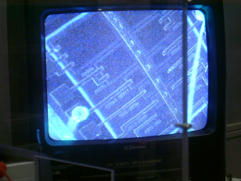
Thin Film Polarization & Piezeoelectric Loops
The laser vibrometer can measure the piezoelectric motion of a thin ferroelectric film capacitor

Slide 12
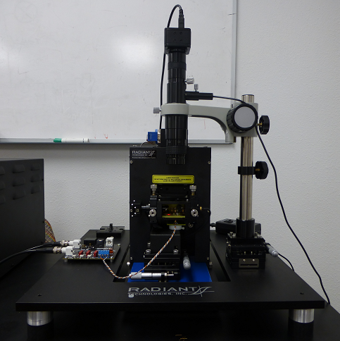
Thin Solid Capacitor Piezo Loop
AFMs work too. Surface piston of the 1µm-thick PNZT at 25 volts and 500 hertz using an AFM. The capacitor is clamped by the substrate.

Slide 13
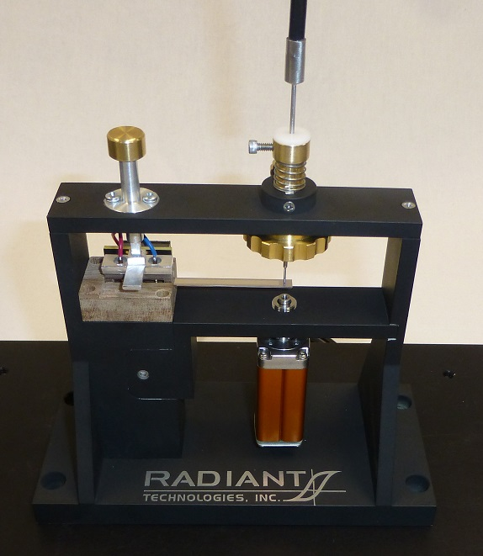
Thin Film PZT on Cantilever
Capturing e₃₁ for a thin film on a cantilever surface is a 3rd technique.

Slide 14
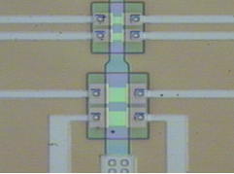

Ferroelectric Transistor Operation
Source & Drain
InOx
PZT
Gate

Slide 15
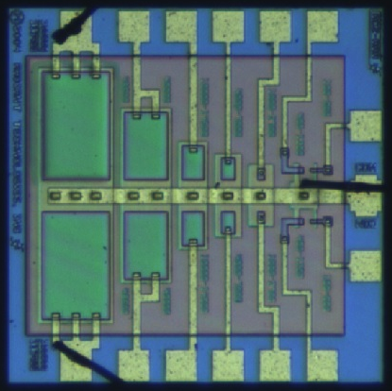
Radiant Technologies
Integrated thin-ferroelectric-film capacitors.
  Radiant has developed a manufacturable process for discrete ferroelectric capacitors.
  Radiant inserts packaged capacitors into its testers as test references.
  Radiant processes thin PZT film wafers and devices for researchers studying non-linear materials.

Slide 16
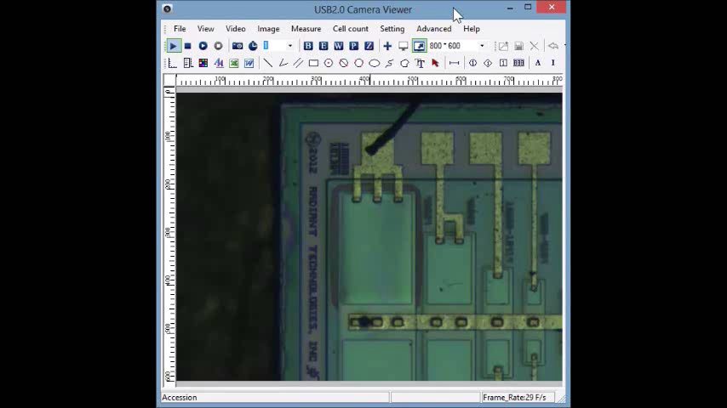
Membrane Capacitors
A three micron membrane with an embedded 1m-thick PNZT capacitor.

Slide 17
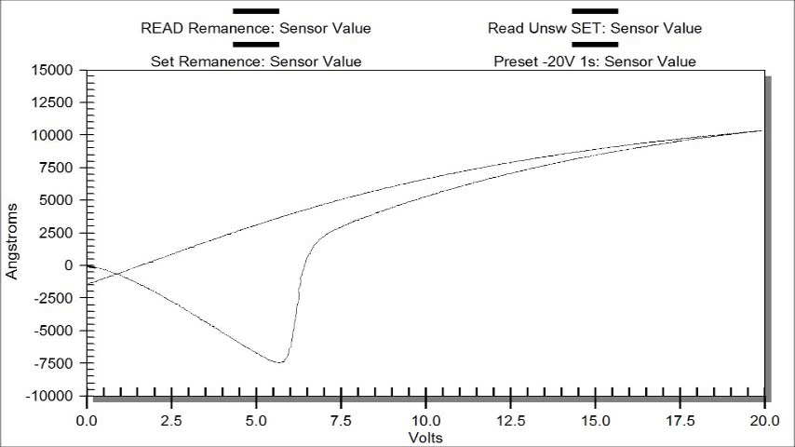
Membrane Capacitors
Remanent strain movie if the same capacitor.

Slide 18
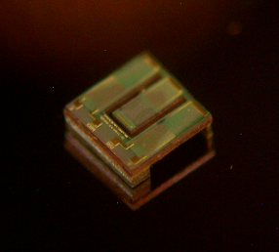
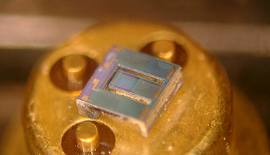
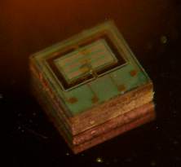
pMEMs Devices
We have work still to do to reliably generate reproducible devices.
.

Slide 19
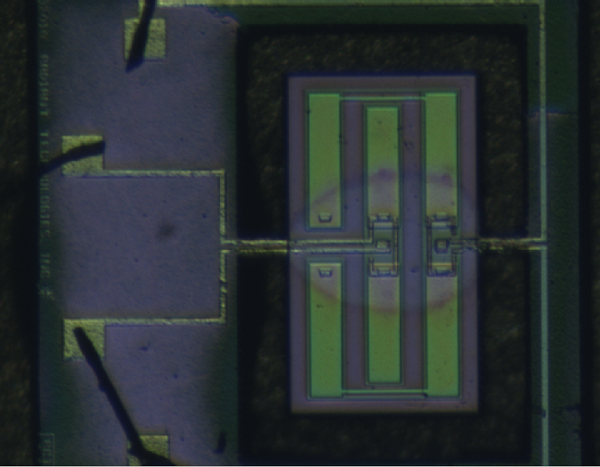
Mechanically Coupled Capacitors
DRIVE
Actuator
Actuator
Sensor
RETURN
1.2mm
Sensor
Actuator
GND

Slide 20
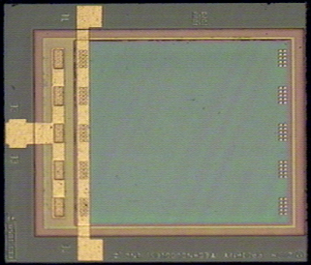
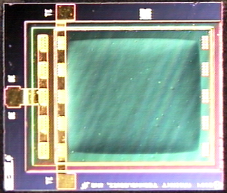
1 mm² Membrane
White Light
Numarski
A 1-square-millimeter capacitor with the majority of its surface as a membrane. In white light the membrane looks smooth but in Numarski the membrane is unmistakable.

Slide 21
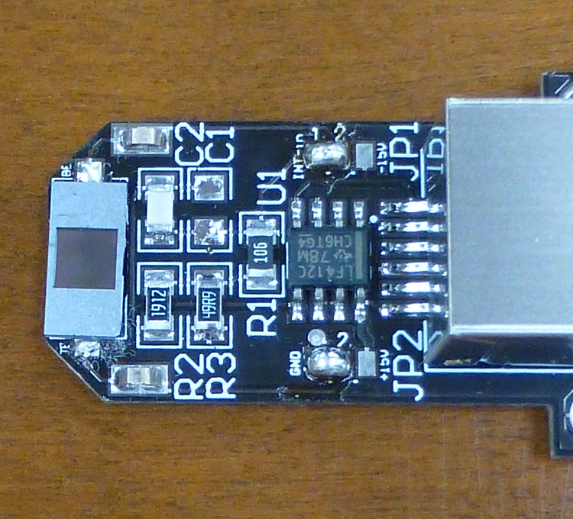
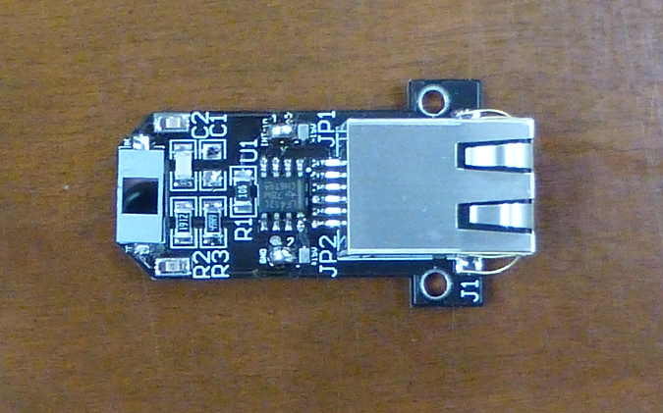
16mm² Membrane
A 16 square millimeter membrane soldered directly to a PCB with an on-board charge amplifier that connects to the Radiant EDU educational tester using telephone cable.
Pyroelectric constant is -22nC/cm2/°K.
The membrane is too fragile to be touched by a human.

Slide 22
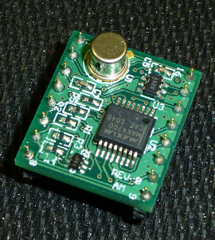
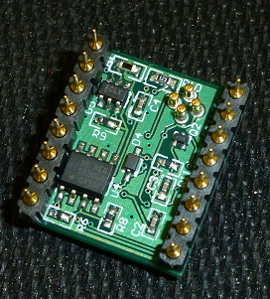
Autonomous Analog Switch
This entire PCB with discrete components and a packaged ferroelectric capacitor can be shrunk into the same solid state switch package on the PCB in the left image. This circuit can stand-alone and resist disturbs from dramatic power-line voltage events.

Slide 23
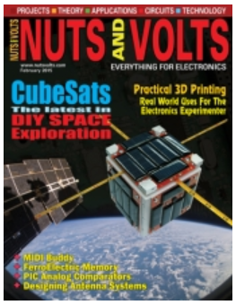
Nuts & Volts Magazine
“A Simple Ferroelectric Memory”
February 2015 Issue

Slide 24
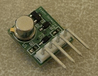
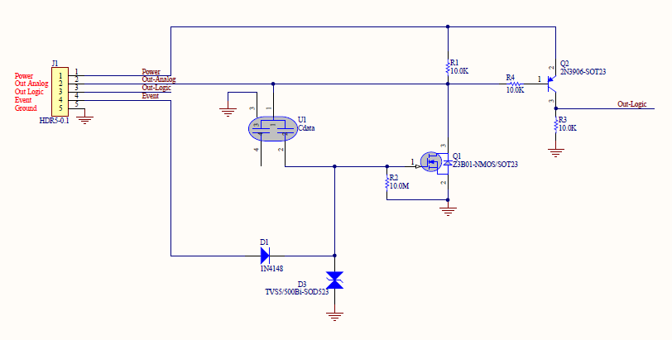
Ferroelectric Circuits
Autonomous Event Detector
Autonomous Memory
Event Input Line
Output Buffer
Ferroelectric Capacitor
Input Overvoltage
Protection

Slide 25
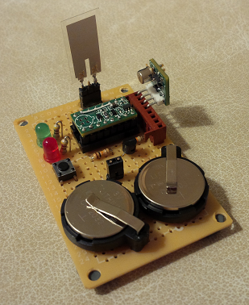
Demo Board - Piezo
This piezoelectric flapper is a Measurement Specialties, Inc. LDT0-28K Piezo Film Sensor. Bent 90 degrees, it generates exactly 7nC of charge, precisely the amount required to saturate one of Radiant’s Type AB 20/80 PZT or Type AD 3/20/80 PNZT thin film capacitors.
The Radiant ferroelectric capacitor is encased in the TO-18 transistor package on the Event Detector board.
Piezo Flapper
Event Detector
Latch

Slide 26
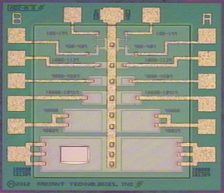
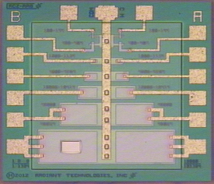
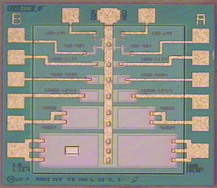
Magnetoelectric Sensor
Deposit magnetically sensitive material on membranes to make magnetic field sensors. Below are dice from a wafer prepared for this experiment but which have not yet seen the backside DRIE. This project, executed in a CRADA with SPAWAR, is difficult!

Slide 27
Best Magnetoelectric Response
(so far)

Slide 28
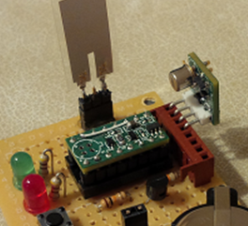
Autonomous Event Detector Set by a Magnetic Field?
Can we magnetomechanically switch the ferroelectric capacitor and control the switch?

